Slide 1

High Level Development Forum:
ACCELERATING REFORMS FOR SUSTAINABLE DEVELOPMENT
Session:
Water management, climate change and disaster reduction
Reforms in Water Sector - Water Resources Management
Tashtanaliev К.Zh, Director of the SWRA under the KR Government

Slide 2
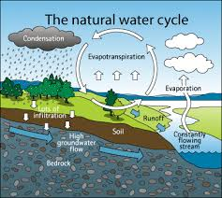

Slide 3
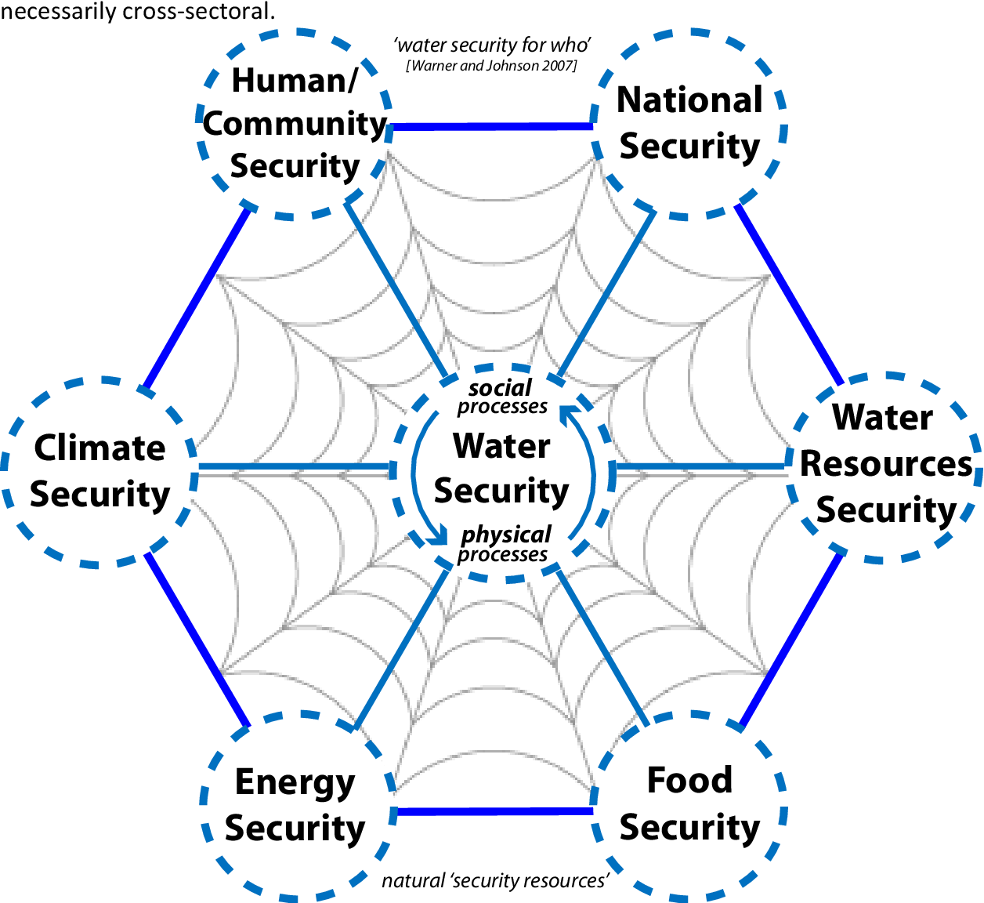
Water Resources is the basis of Sustainable Development
National Water Security:
Water for life;
Water for development.
Food Security;
Energy Security;
Environmental Safety.

Slide 4
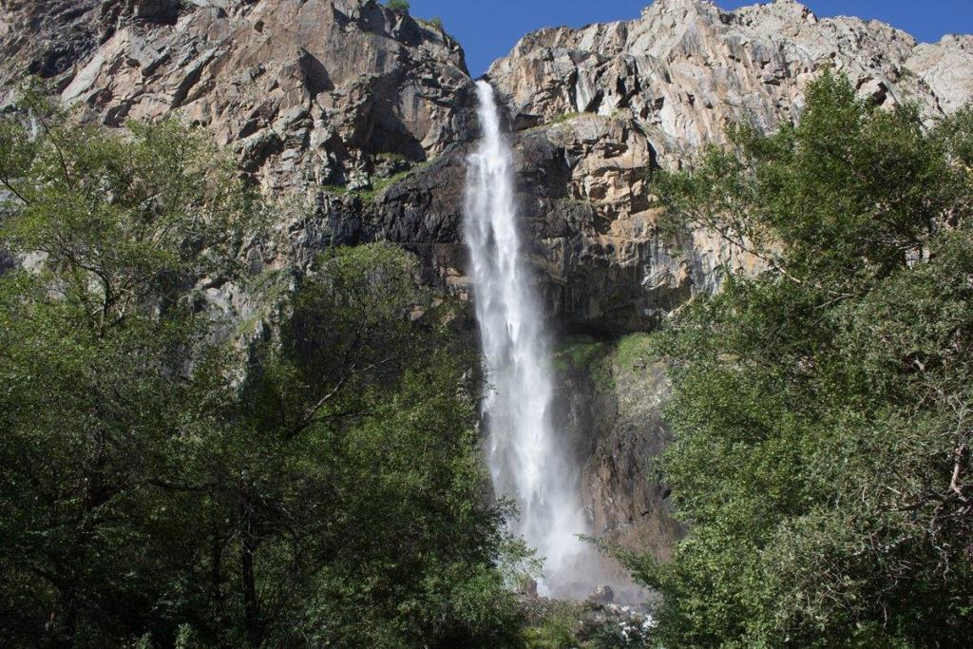
National Water Security
Water resources are one of the main national wealth. They play a crucial role in the development of the productive forces not only of our republic, but also of Uzbekistan, Kazakhstan, Tajikistan and China.;
The country's water resources are fully formed on our territory: the volume of glaciers - 390 km³; more than 2,000 rivers over 10 km long; the volume of water in the lakes - 1,745 km³; fresh groundwater reserves - 13 km³;
The volume of river flow is more than 50 km³ / year; 20% is used for the country's economy, the rest flows to neighboring countries;
40% of the population does not have access to clean drinking water;
Guaranteed water supply for existing irrigated lands is 23%;
According to the projections of experts, for the sustainable development of the country's economic sectors, there is a need to increase water withdrawal up to 40%

Slide 5






Food Security
There is more than 1.2 million hectares of irrigated land in the Republic. The possibility of introducing new irrigated land is more than 1 million hectares.
According to the UN FAO, 0.2 ha of irrigated land is required per 1 person to provide food for the population. In Kyrgyzstan, there is 0.14 ha of irrigated land per 1 person;
To ensure the safety of the population and settlements, it is necessary to adopt the State program for the construction of mudflow reservoirs on small rivers of the republic;
Virtual Water Indicators for Kyrgyzstan :
 | m3 / ha
Wheat | 3600
Meat | 4500
Vegetables | 4500
Cotton | 12000
Kidney bean | 7000
Sugarbeet | 9000

Slide 6
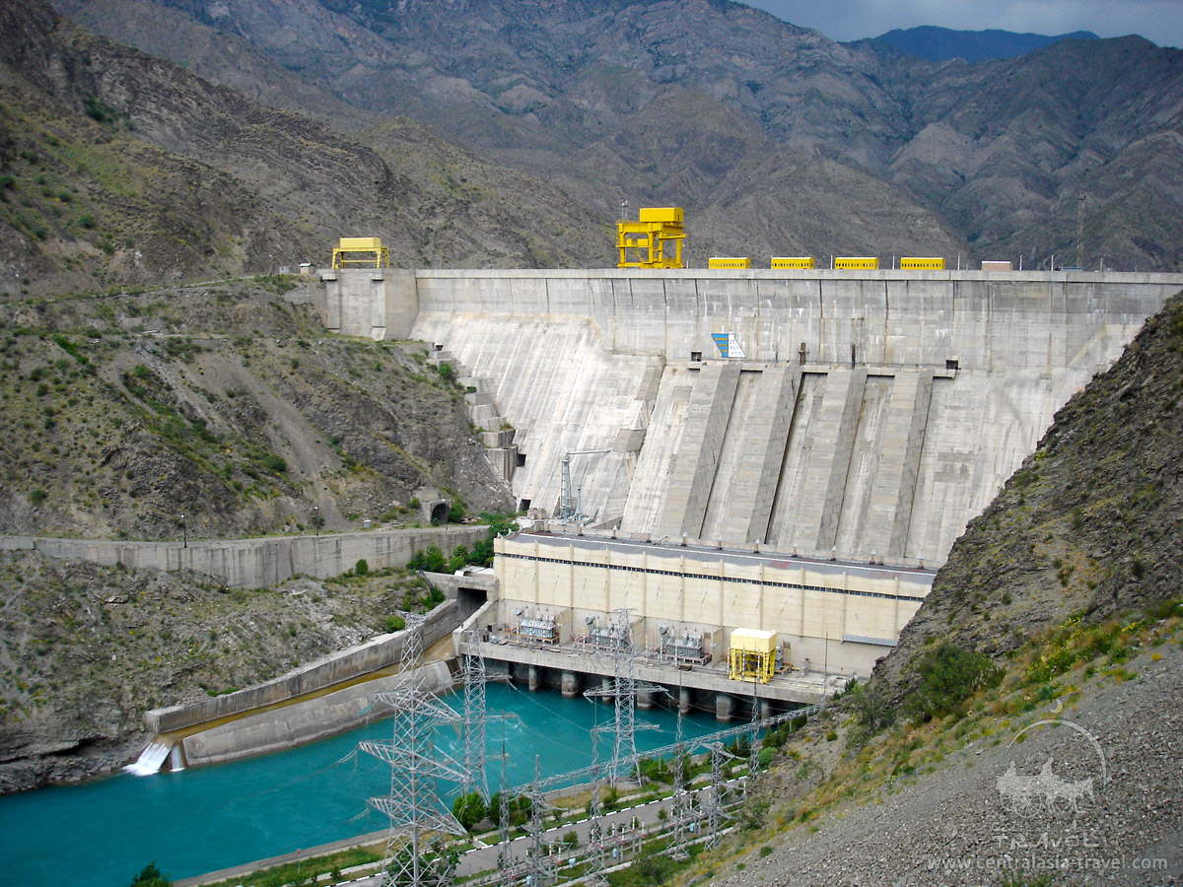
Energy Security
Currently, the republic’s hydropower potential is 18% (for large hydropower plants - 19.5%, and for small hydropower plants - 4%);
The hydropower potential of the republic is estimated at 245.52 billion kWh of electricity;
The country has 16 large and medium-sized hydropower plants with an annual output of 11 billion kWh.
The commissioning of new capacities is outracing the growth rate of the load in the power system. Over the past ten years, only 1 power unit for 120 MW of Kambarata-2 hydroelectric power station was built and commissioned;
It is planned to commission new cascade of the Upper-Naryn hydropower plants, the Karakeche TPP and the Kambarata-1 hydropower station, the second power unit of the Kambarata-2 hydropower station, as well as small hydropower plants by region.

Slide 7
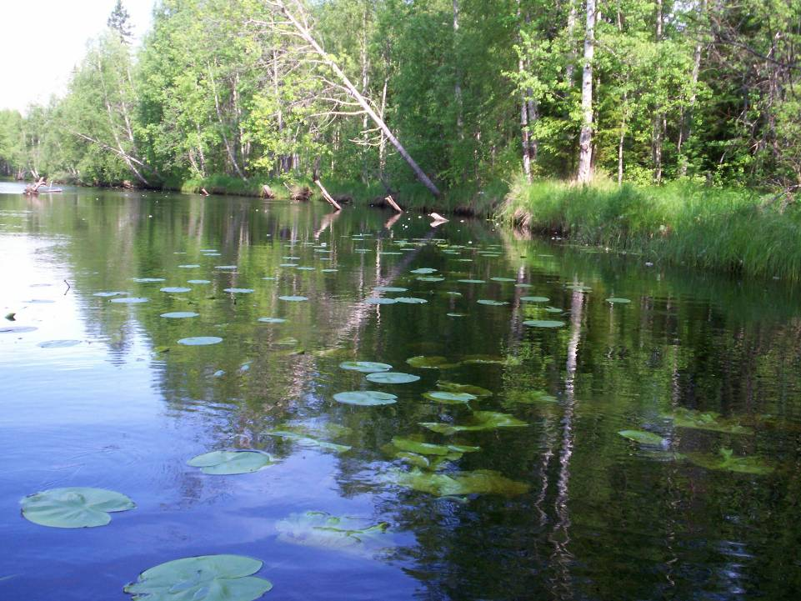
Environmental Safety
Nature and its components are the national treasure of the Kyrgyz Republic, one of the main factors of its sustainable socio-economic development;
The existence of ecosystems depends on the availability of sufficient water;
Article 64 of the Water Code of the Kyrgyz Republic includes a provision on determining the minimum requirements for environmental runoff for rivers and water bodies of a country in order to preserve fish resources and water ecosystems;
There is an emergency to consider ecosystem needs in water.

Slide 8
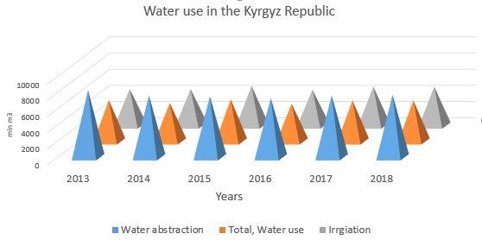
Why act now ….
Population growth and economic development make increasing pressures on water resources.
Kyrgyzstan, as a mountainous country, is most vulnerable to the consequences of Global Climate Change:
increase in air temperature;
glaciers melting and their reduction,
river flow change;
Emergency situations growth.

Slide 9
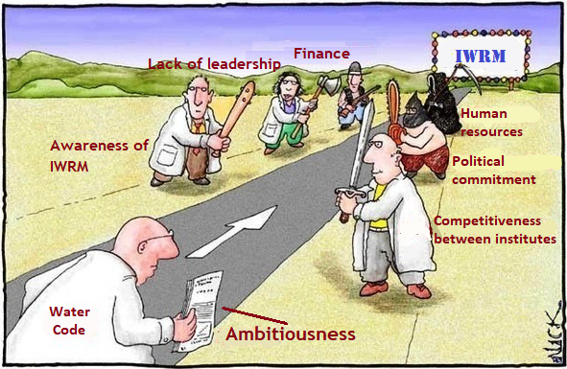
Water Code is the main regulatory instrument
Reasons for delayed implementation of the Water Code:
Ambitiousness
Lack of institutional framework (SWRA) and effective solutions
Lack of financial and human resources
Political situation

Slide 10

State Strategies and Development Programs
National Development Strategy of the Kyrgyz Republic for 2018-2040
The program of the Government of the Kyrgyz Republic “Unity. Trust. Creation”
State Program for the Development of Irrigation until 2026
The development strategy of drinking water supply and sanitation systems in settlements until 2026

Slide 11

Challenges:
Climate Change
Deficiencies of the legal framework: Water Code and other legal instruments require harmonization, additions and amendments
The insufficiency of strategic documents for the development of the water sector: the adoption of the National Water Strategy and River Basin Management Plans is necessary
The State Water Resources Agency was established recently, therefore political, financial support is needed.
Depreciation of infrastructure (80%), losses of up to 40%, both in irrigation and in drinking water supply
Insufficient financing, inadequate tariff policy and payment for the use of water resources as a natural resource has not been introduced

Slide 12
Results achieved since 2013
The State Water Resources Agency was established (Decree of the Government of the Kyrgyz Republic dated July 30, 2019, # 383);
Work is underway to create five of its River Basin structures;
Unified Water Information System was created;
A basis has been prepared for the transition to River Basin Management (river basin boundaries, regulations and organigram of councils, plans and computer models).
Have been developed:
Draft National Water Strategy until 2040
Roadmap for the Water Code implementation

Slide 13
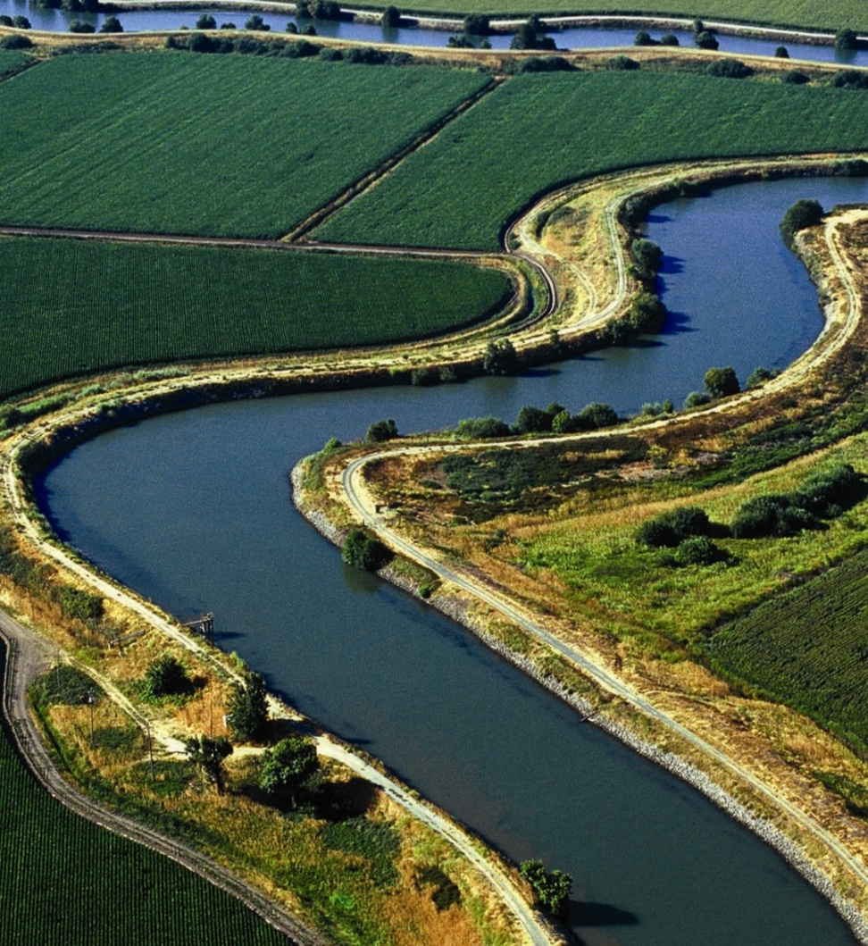
Expected results:
(1)
A single authority at the central and basin levels that will ensure coordination and improve management in the context of climate change.
Monitoring and accounting of water resources will improve, which will allow for modeling and scenario building. This will have a positive impact on preparatory measures for adaptation to climate change and investment in infrastructure.
Improved accounting and economic regulatory methods will reduce losses. Released resources can be used.
Rational use of water resources will be ensured and monitored by river basin structures.

Slide 14
Expected results:
(2)
Improved quality of water resources due to the use of regulatory and economic instruments.
Economic instruments will help the sector generate its own resources for subsequent investments, including the possibility of creating a market for water demand.
Shift to basin approach and progressing on developing national water strategy and basin plans with investment priorities which will include:
By 2026 it is expected that:
Drinking water and sanitation:
1805 villages will be provided with clean drinking water and about 2 million people will have access to clean drinking water;
Irrigation:
66.5 thousand ha of new irrigated lands will be introduced
water supply to 51 thousand hectares of land will increase,
9.5 thousand hectares will be transferred from pumping to gravity irrigation.
ameliorative condition of 50 thousand hectares of irrigated lands will improve.

Slide 15

The support is needed for:
The development and implementation of measures outlined in the upcoming National Water Strategy, within the framework of which sectoral strategies will be implemented such as: Irrigation development program 2026 and Strategy for the development of drinking water supply and sanitation systems 2026 and so forth…;
Modification of the water sector regulatory framework (Water Code, National Water Strategy, Roadmap, etc.)
Organization of an integrated monitoring network on the quantity and quality of surface and groundwater as well as development of mechanisms to ensure financial sustainability of the water information system because without reliable data it is not possible to manage the emerging risks;
Strengthening the state body in organizational, financial and technical aspects and establishment of structural units for effective management at the national and basin levels.

Slide 16
Рахмат,
Thank you for attention
Спасибо

